Slide 1
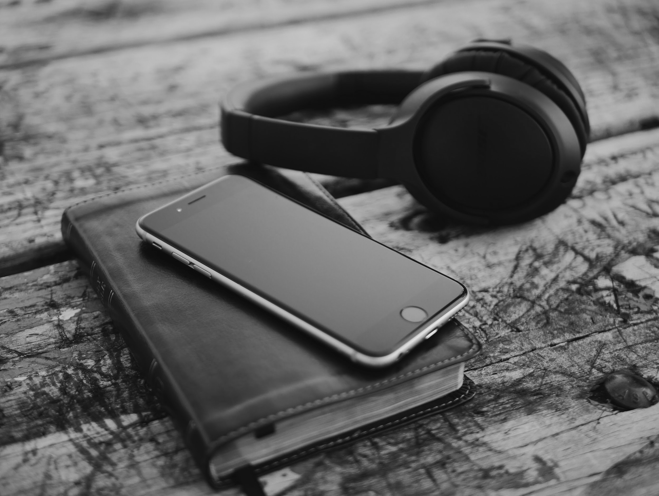
Find the Story
Beyond the Stacks:
Creating a Library Podcast
Eva Stepanian
Digital Strategies Librarian
Brampton Library

Slide 2
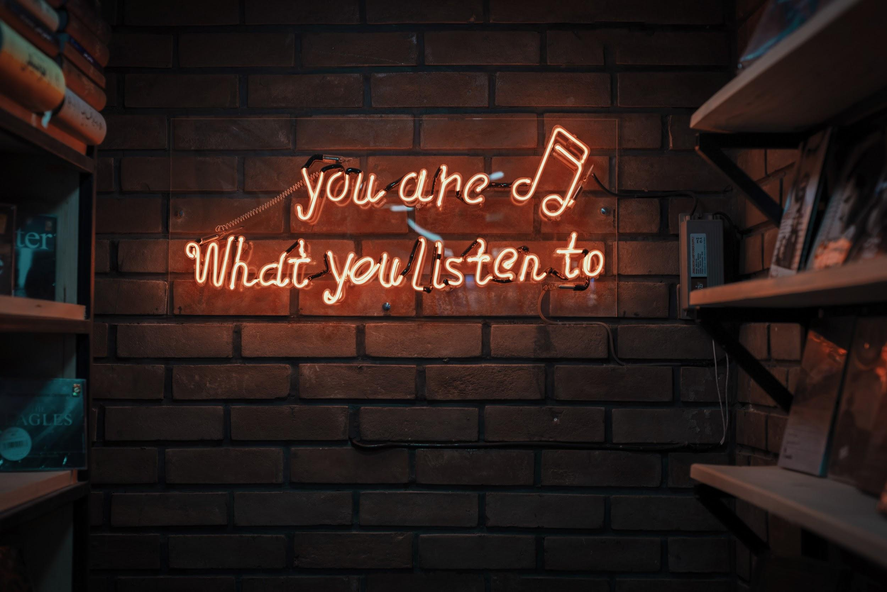
Concept
Content
Episode planning
The Technical
Challenges
Lessons
Notes:
Poll:
Podcast listeners?
Podcast creators?
Budding podcast creators?
Social media/video/marketing content creators?
My focus is really going to be about finding the story. We will look at:
Getting the project off the ground in terms of the organization and your brand
Episode planning and creation
A messy summary of the technical journey
Challenges
Lessons

Slide 3
Concept (buy In)
Notes:
WHY
For everyone: Audio and Voice
Statistically the fastest growing medium.
According to Edison Research and Triton Digital, there are now 62 million Americans listening to podcasts each week, up from 19 million in 2013.
A very easy to understand (unlike other social) and long standing method of information and entertainment consumption - we are multitaskers, audio fits right in.
Stories (for us)
Our podcast is not, I think, what you would expect of a library podcast: We don’t discuss book recommendations, or interview authors, or review popular titles. What we do is share stories (hence the name) - and this is really important. I was at work one day and a colleague of mine who has been working in the library for 30+ years was shuffling through newspapers on a mission to find something, and when I inquired about what she was doing she went on to tell me, basically, that years back there had been a customer who would vandalize (so to speak) certain pages of a certain newspaper - and this went on for months. The customer would always use pencil and always target the same paper on the same day, on the same pages - and it became clear to me that this staff member has launched an amateur investigation into this, she tracked the behaviour, tried to narrow down who was committing this nuisance...anyway, she never caught them, and now she was suspecting the person - or a copycat - was striking again!
It was all at once captivating and hilarious to me that this was happening behind the scenes at a public library and I was struck, not for the first time, that this could easily be a TV show ...or, as it turns out- a podcast. The public, and even our other colleagues and counterparts in other libraries, have no way to know this and other equally entertaining things like this are happening every day at work, and it’s a shame not to share it. We, as humans and consumers of content love stories because they help us to relate to each other and also allow us to better understand ourselves through each others’ experience - whether through difficulty or humour. And so, Brampton Libraries Stories was born. (cick)
It was a great combination of good timing in terms of the inspiration to share these stories, and the rising world of audio content that was becoming more and more difficult to ignore.
CLICK: Concept: Buy In
For some this might be too much of a “long term, big picture” approach, which is fine, but for us and the volume of content that we produce, and the work back that I like to build in, this was sort of ideal.
Concept: sell the concept. I had a formal project plan, because this was part of a larger project of me - but in essence, this was very much a “pitch”.
Even if you don’t need this level of a “proposal”, creating the pitch, in long and short form, helps form the “elevator pitch”. Essentially, knowing the “why” of your project and being able to tell others about it succinctly and with enthusiasm, helped to coerce many of our guests...
Co-host: sounds like fun, but seriously, it’s a commitment.
Guests: know at least 6 of them in theory

Slide 4
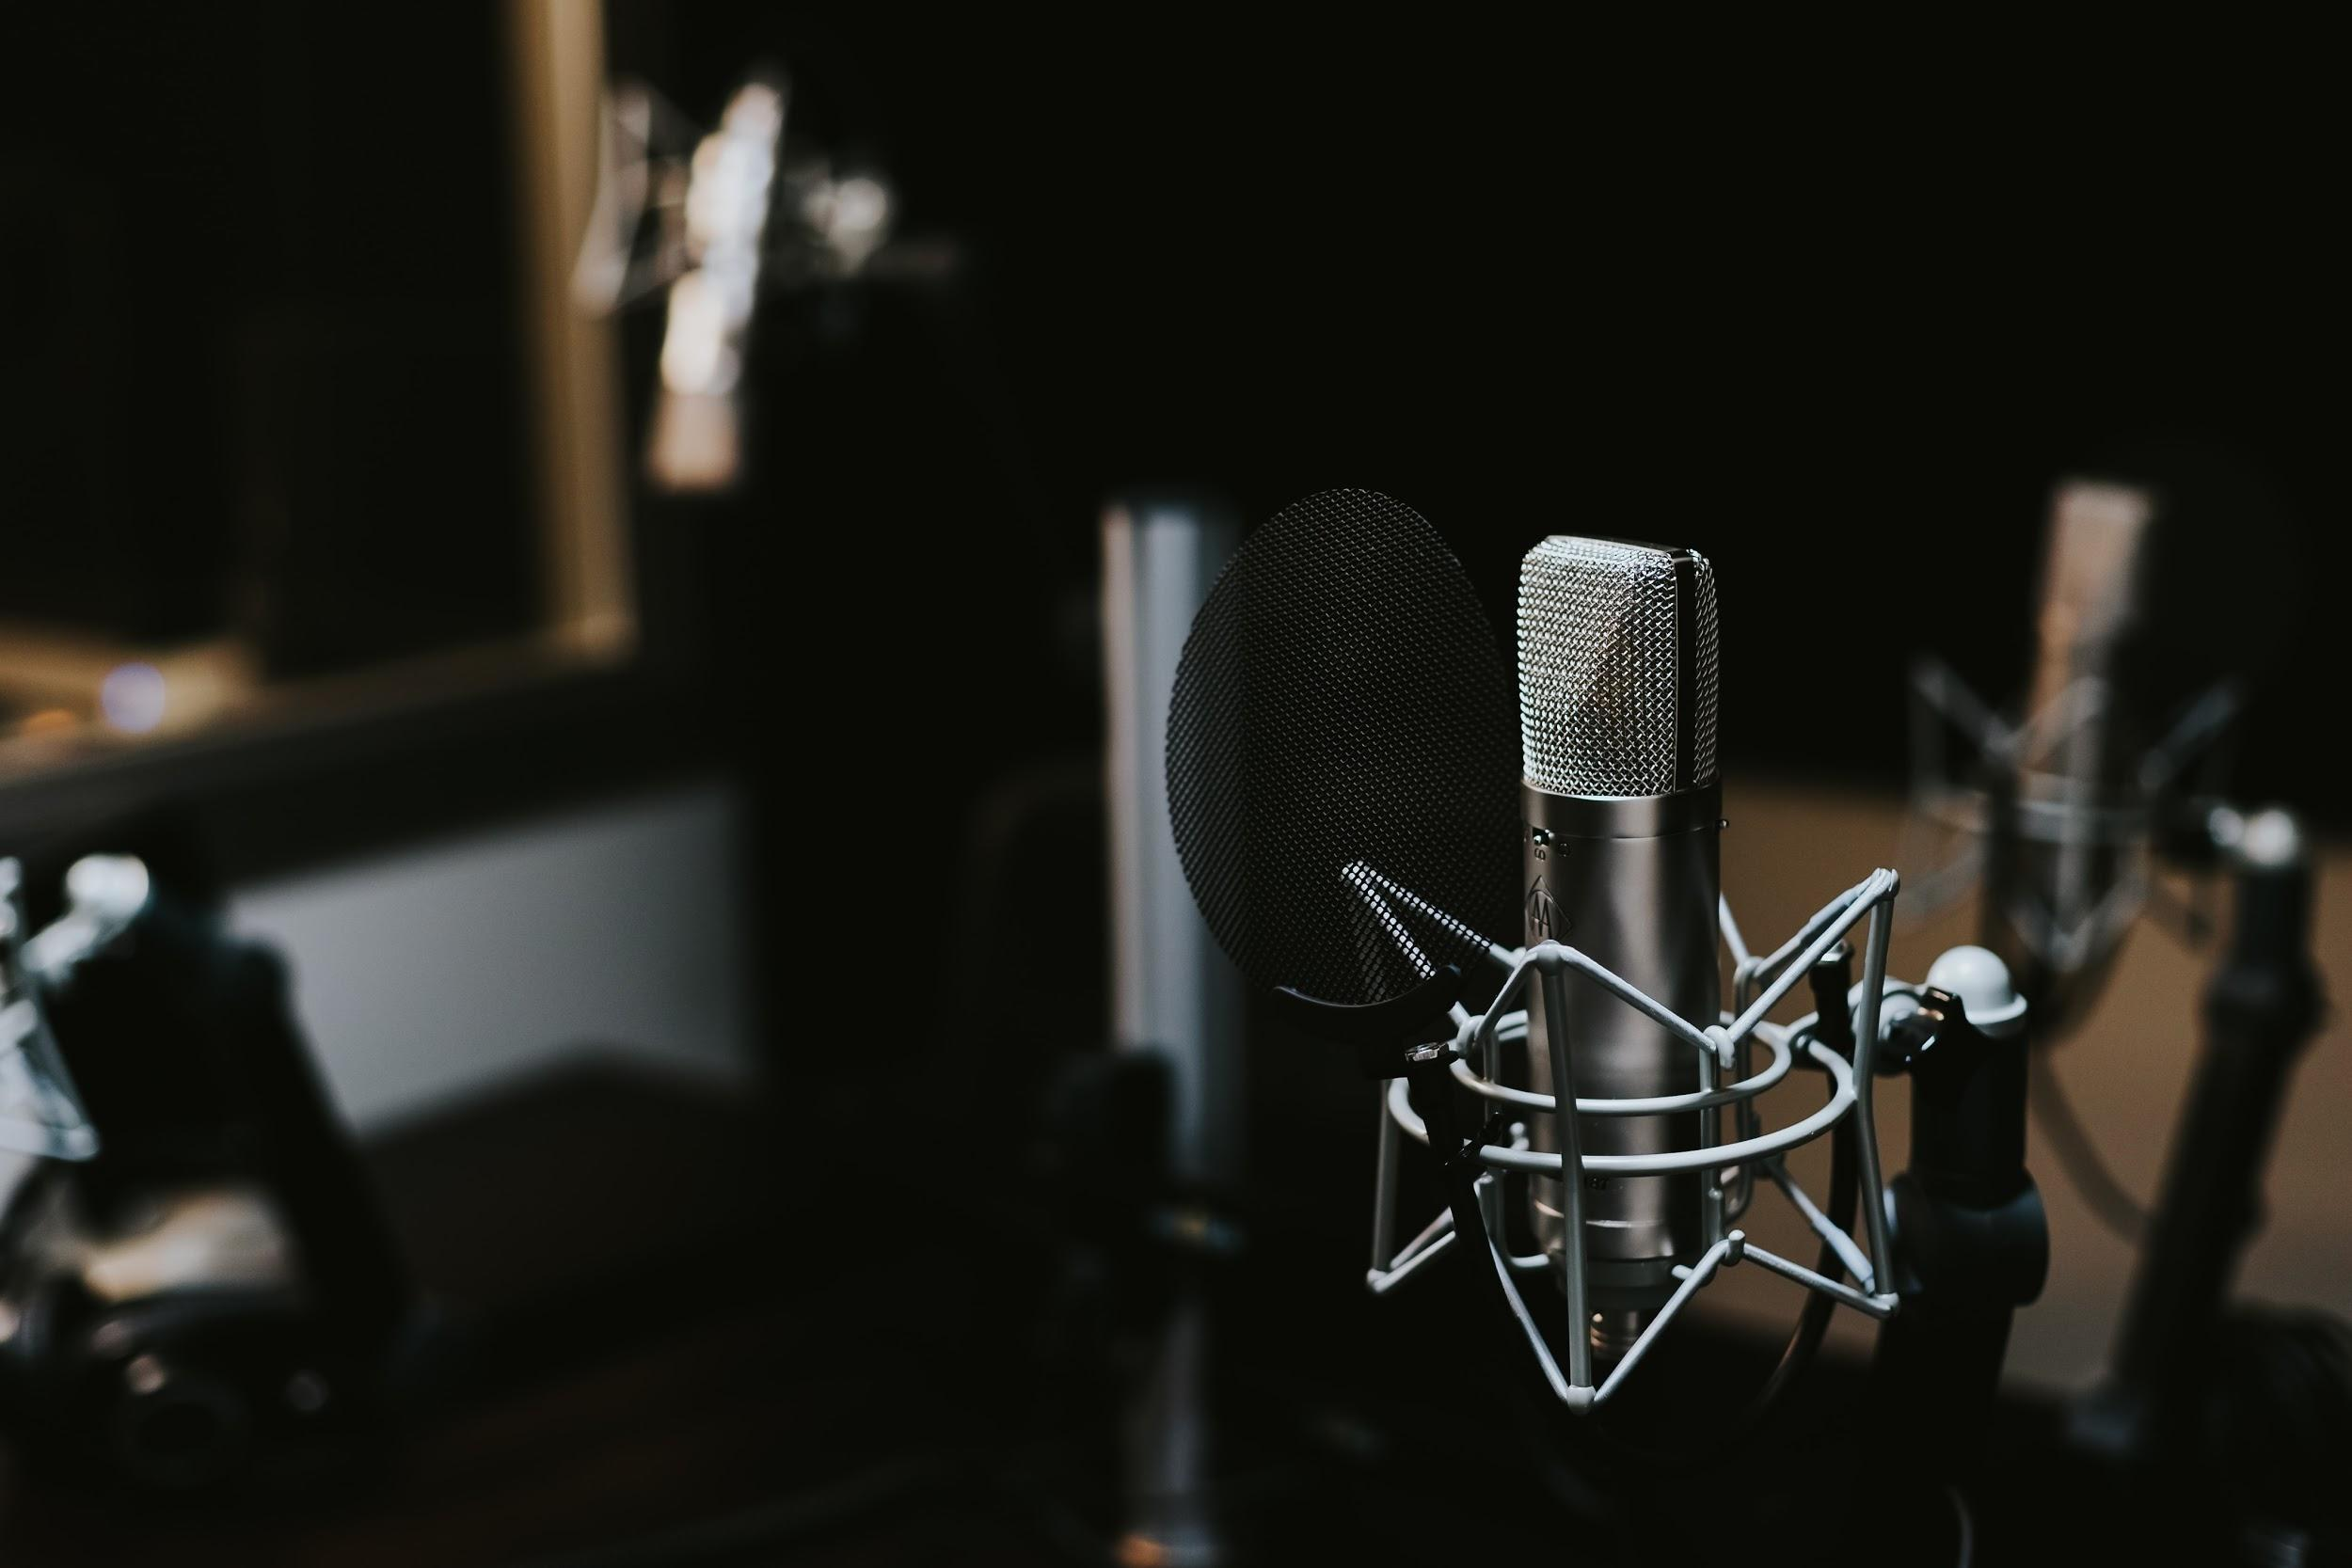
Sustainability
& resources
Content: brand & tone
Notes:
SUSTAINABILITY and Resources:
-resources (design, music, guests, tech, software, IT, marketing).
Consider ROI - we decided to trial the project to determine this. More on this later.
Longevity (a full season pilot?)
Part of our content offering, keep it consistent.
Why am I emphasizing consistency? In my research and personal consumption of podcasts, I’ve learned that unlike youtube videos which people will consume as one-offs, podcasts are something people subscribe to and come back to regularly - so your content needs to be regularly available, and reliable in it’s delivery.
Branding
With consistency, you’re building an audience base and interest. You also will be doing with with branding, after all, this is just another kind of branded content, think of it as such.
Being aware of your brand and it’s voice is important because this will likely be the first time that your brand is presented in audio, and this is significant. Know your voice and tone. Listen to podcasts, talk to your colleagues, go into branches - what does your brand sound like or want to sound like? It helps if your social voice is already defined - just figure out if you want to extend this, or change it.
While I don’t want you to overthink it, I do want you to realize that being “the brand” is uniquely different in audio. Video is obvious, social has many facets and imagery…
Audio is more personal. One of the great drivers of podcast consumption growth is that podcasts are the ultimate multi-tasking content format. The 2019 podcast statistics show that multi-tasking is in full force. 59% have listened while doing housework. 52% while driving. 51% while cooking. And 46% while going for a walk.
You may think that if someone is listening to your podcast while driving or doing the housework that they are distracted, but in fact they are allowing your voice and your content in to a time where you weren’t present before. Ever try to mow your lawn while reading a blog post? Or while watching a YouTube video? Doable maybe, but not advisable. Audio takes over more of their time (30-40min episodes, measured to commute times) but also takes over more of the imagination - as the listener fills in gaps and makes associations necessary to make sense of what they are being told.
I would argue if this isn’t something you’re set up to do for a cohesive season at a time and potentially onward, consider doing something different. You can still test out your brand voice and take part in the audio space by being a guest.
So if you’re launching a podcast - what are you sharing? NEXT SLIDE

Slide 5
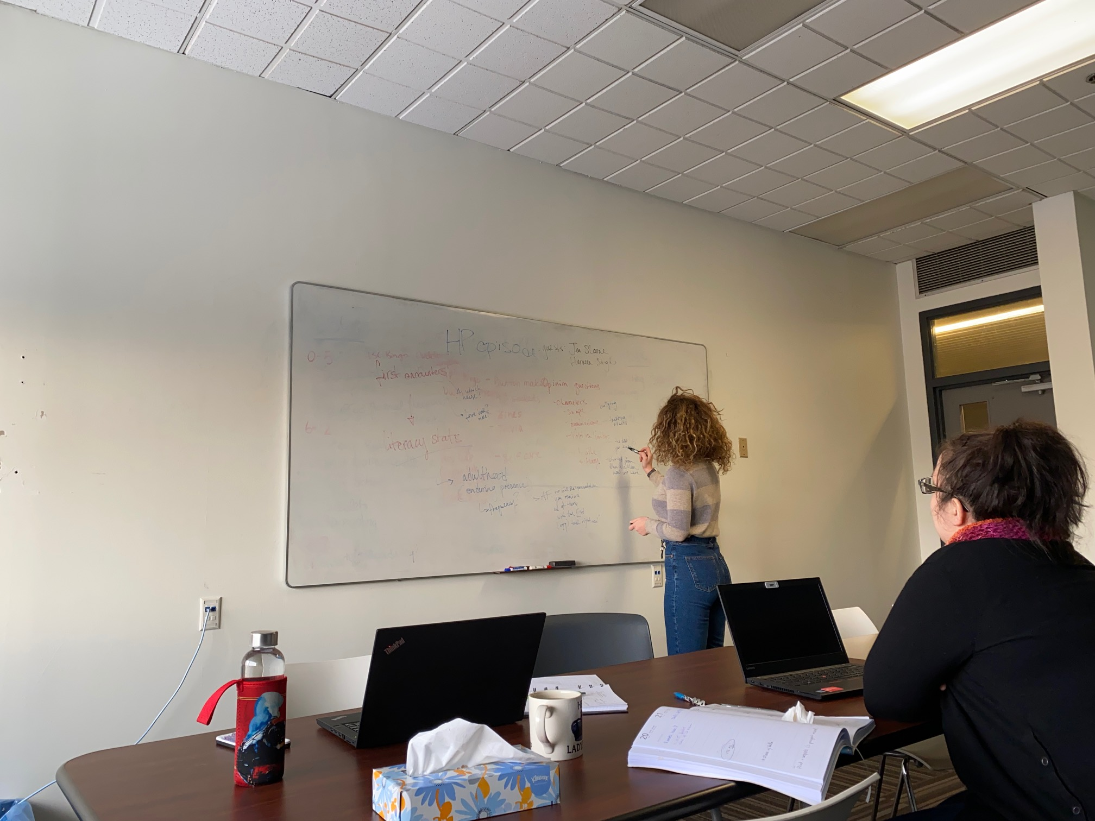
Episode Planning
Value
Scripting
Guests
Notes:
Episode Planning:
As I said, I think the key to a successful podcast (And successful branded marketing) is thoughtful content creation. For us, this meant putting in a lot of effort into episode planning, which is sort of misleading when I go on to tell you that we relied only on “invisible scripts”.
Invisible Scripting
We knew we would be sharing stories from our staff - so naturally, we sourced these stories.
We built questions and observations around these topics, but never wrote out any other speaking points.
Had an idea of the stories our guests would share, as well as what the focus or theme of the episode would be.
The things that were set were the intros and outros, Script your intros and outros, you are not as smooth as you think you are.
Same goes for your guest intros. Don't give a bio, but consider a fun fact about the person, an anecdote, what have you.
Prepping guests: We communicated with them the theme of their episode and the stories we wanted them to think about sharing.All of our guests put thought into what they would share ahead of time, some came in with talking notes - and I’ll tell you, overall, the discussions with no talking notes, or with forgotten talking notes, Surprisingly, resulted in less editing. Why? Because the conversation FLOWED - wasn’t stop and go.
We also informed them that the edited product would be shared in advance
You will find that your episodes may take on a sort of Formula, which I would encourage. It is good for you (in terms of episode planning and hosting) and for your listeners.

Slide 6
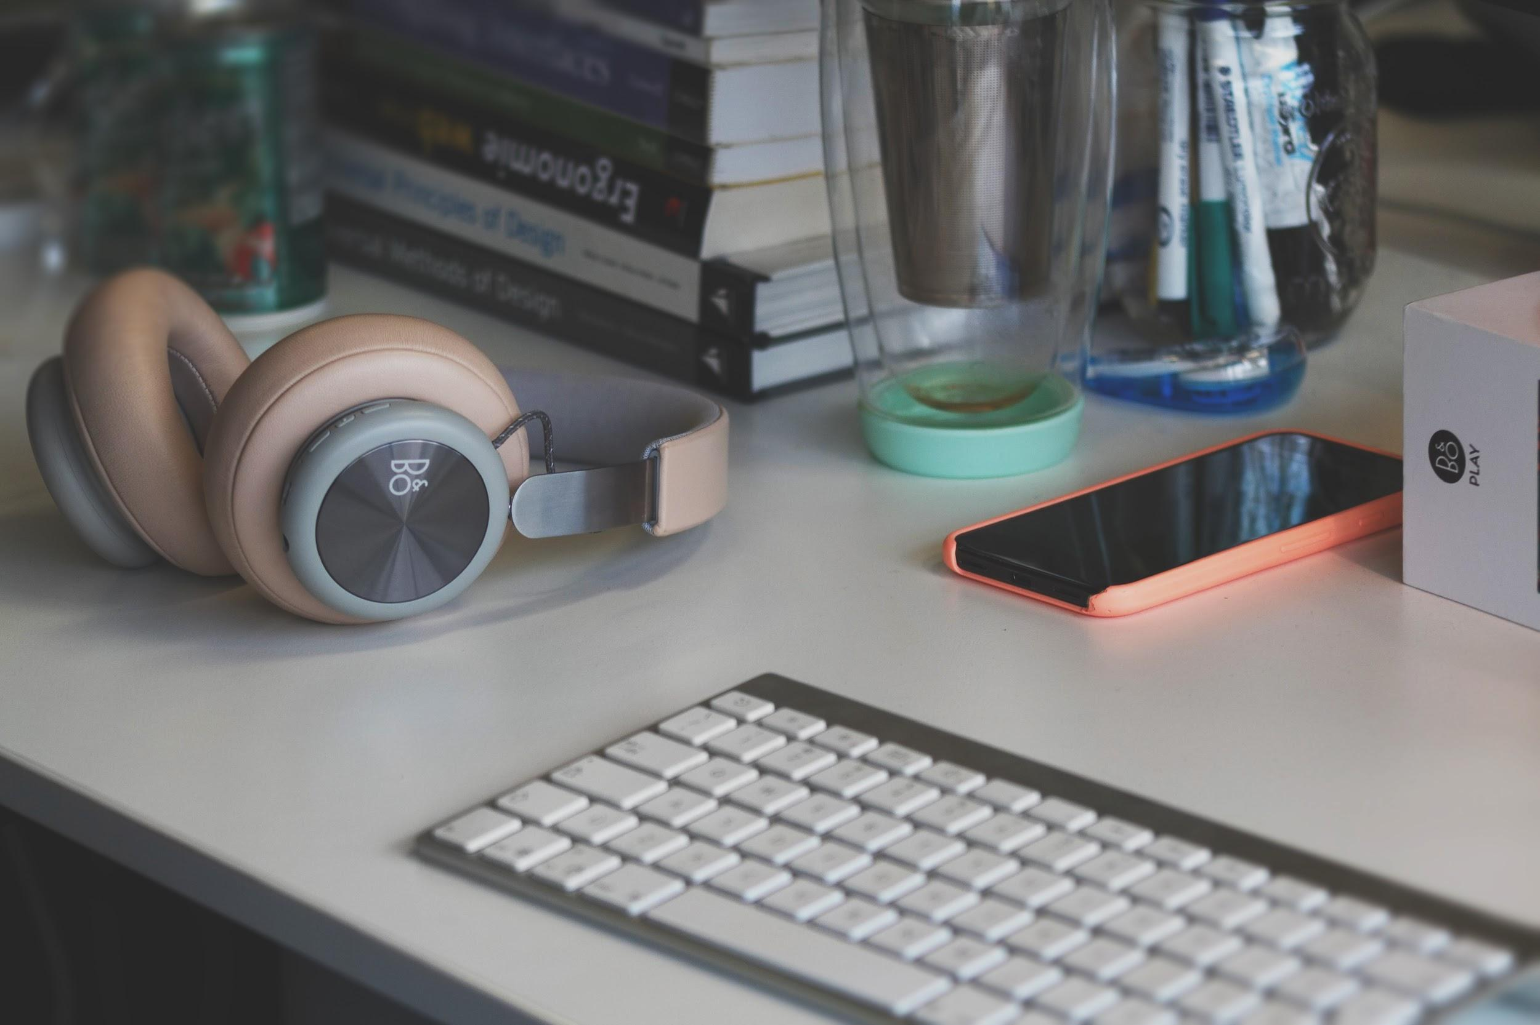
Technically speaking
Notes:
We went with a “bulk” recording schedule built momentum both for episode planning and recording.
But technically speaking, for better or for worse, we were working with what we had.
How did we record this podcast?
Audio Recording Studio
To have an ARS at your disposal seems pretty perfect, right? And on paper, it is. I knew from the get go that there would be some training involved for me get started, but I’m telling you now folks, for someone with zero previous experience, “some training” is a comical understatement.
Took a one - on - one orientation, had staff willing to help when I got stuck, had the world wide web - and all of these elements were VITAL.
So, I will say that if you have an ARS to work with, see if you can get someone involved that knows SOMETHING, and if you don’t - I’m starting to realize that an iphone and mic attachment may not be the worst thing that ever happened to a podcast.
In anycase, Pro Tools (software) and I had to become friends. It was hard. And if I’m being completely frank, I am maddeningly stubborn and at this point in the game I felt too committed creatively to give up technically. Do with that what you will.
Dynamic mic and 2 diaphram condenser mics - phantom power!
It was slow. Our daily struggle was high, and our success indicators were low: only 1 mic died today? AWESOME!
Slide 6: VIDEO

Slide 7
The struggle is real.
Notes:
I’m going to tackle this topic sort of...backwards.
As I said, I think the key to a successful podcast (And successful branded marketing) is thoughtful content creation.
So before I get into the details of what that means and what it looked like for this project, I want to get the obvious stuff out of the way:
How did we record this podcast?
Audio Recording Studio
To have an ARS at your disposal seems pretty perfect, right? And on paper, it is. I knew from the get go that there would be some training involved for me get started, but I’m telling you now folks, for someone with zero previous experience, “some training” is a comical understatement.
Took a one - on - one orientation, had staff willing to help when I got stuck, had the world wide web - and all of these elements were VITAL.
So, I will say that if you have an ARS to work with, see if you can get someone involved that knows SOMETHING, and if you don’t - I’m starting to realize that an iphone and mic attachment may not be the worst thing that ever happened to a podcast.
In anycase, Pro Tools (software) and I had to become friends. It was hard. And if I’m being completely frank, I am maddeningly stubborn and at this point in the game I felt too committed creatively to give up technically. Despair was real and I did video updates to try and share the journey because...it was a journey.
Our daily struggle was high, and our success indicators were low: only 1 mic died today? AWESOME!
Editing
Chose

Slide 8
Technically speaking
Notes:
Did that make you feel a bit frantic? Lost? Feeling slightly embarrassed for me? ALL OF THE ABOVE AND MORE, friends.
My mistake, in hindsight, was that I started too big. I aimed to learn too much - and this became very overwhelming, very quickly. Why did I decide that on top of producing and editing a podcast series, I, a person who maddeningly uses the terms “note” and “Chord’ interchangeably, should be able to record my own jingle? I couldn’t say. But boy was it a humbling experience.
Eventually, I knew enough to get us set up to record, and to have the microphones do what they are supposed to do. And have the audio we capture sound ‘clean’(ish). This was enough.
I have to emphasize that throughout the recordings, It was important for us to have our guests feel comfortable, and, hopefully, notice NONE of what you were just witnesses to - and I’ll be honest a big part of our confidence and gusto came from - you guessed it - the content and episode prep.
We were really proud of the work we had done to draw out episodes and guests, which contributed greatly to the execution in the studio. The vision for us from our “concept or pitch”, of having staff speak to us as they do in our office space was the goal/vision.
Editing:
Disclaimer: I was fairly confident in my editing skills, which I made sure to cite at during every recording. This made the chaos a little more manageable.
As I said, we went for a record first, edit later plan from the get go. In terms of learning the studio and producing what we thought would be the best product, this worked for us. There are risks either way: may run into editing issues if you save it for later, but may also run out of recording steam. For us, the latter risk was more real.
Used Adobe Audition (via creative cloud) to edit. Fun fact: working offsite one day so I used garageband to edit “Other dooties as assigned” episode - way clunkier and less intuitive. Could just be because I’m used to the Adobe workspace, though.
Another thing to learn: Podcast hosting. But not that kind of hosting. Enter internet.

Slide 9
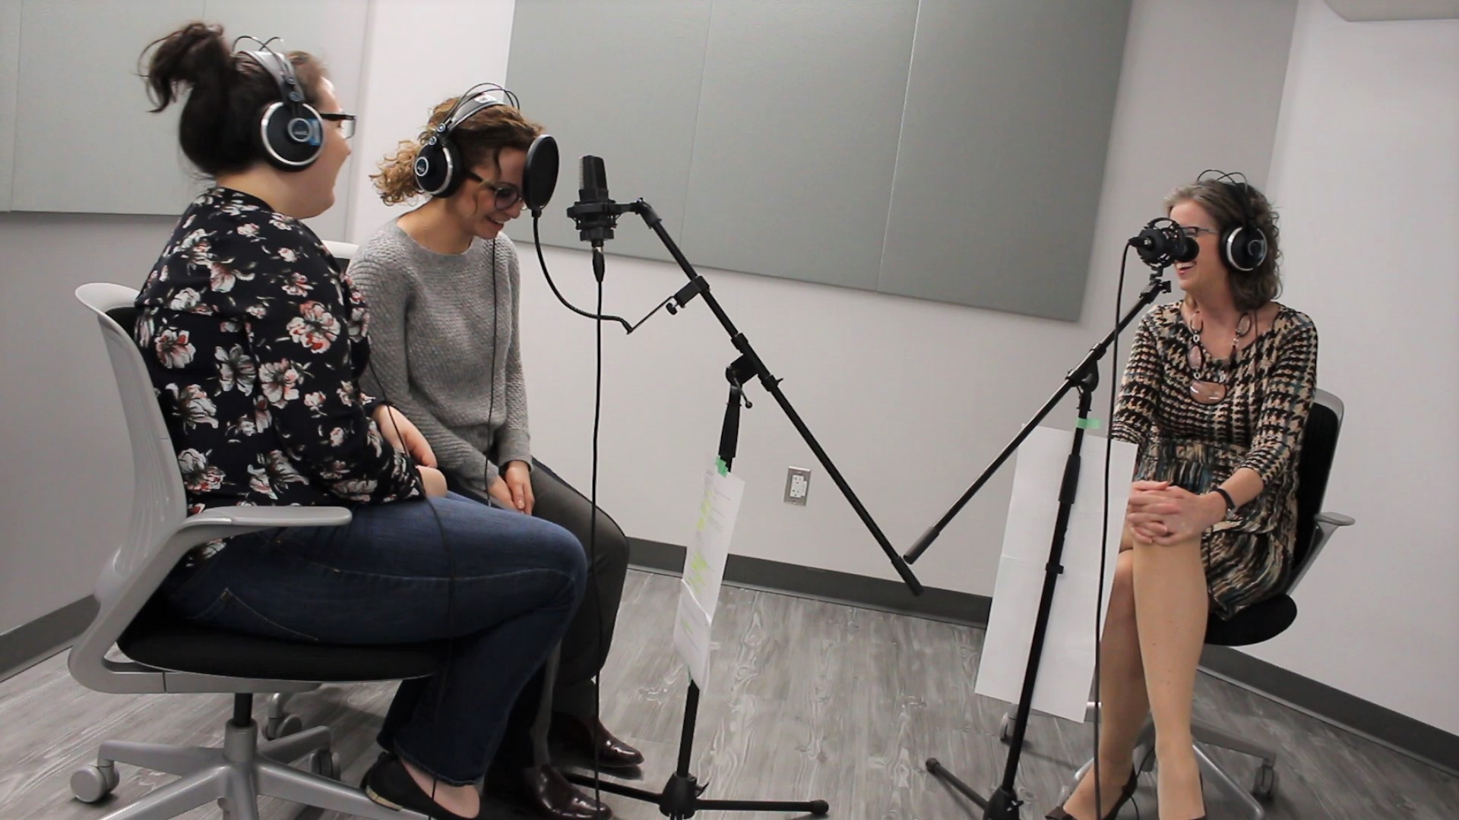
Challenges
Notes:
Challenges
Time. This is obvious but very real. Not only does it suck a lot of time out of your schedule in terms of a brand new workflow, but it relies on others: scheduling everyone and everything else involved (which also informed our recording structure and schedule - many recordings in one day).
The technical challenges I can’t possibly get into but I will say this:
Know when to give up. Know when to scale back. It is better to produce quality content with few frills rather than something with high production value but late/lost interest/doesn’t carry through to the content.
The good news is, this is why podcasts make so much sense for libraries, we have great content and people to talk to. I would, if I haven't already made abundantly clear, lead with this.

Slide 10
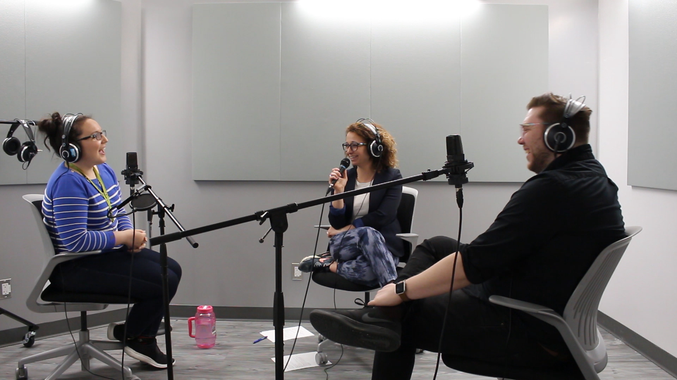
Lessons
Notes:
Remember the part where I told you to hard script intros? Intros and outros are where you get to really plug what you want to plug, it is expected, so go ahead and do it.
Elevator pitch for guests: make it exciting.
Give guests examples of other podcasts that are similar in tone to yours (not content!)
Hosting: Apple required more effort.
You did it! BUT People won’t just know about it, and it will take time to build an audience. This is ok, but do remember that This is a BIG piece of ongoing content that personifies your brand. Use it wisely and share it broadly!
Overall: TBD. But, percieved ROI is relatively high, if compared to other branded content. Unlike social posts or videos, podcasts proved to have a long, slow burn. Which is unique in our experience of our other branded content. This content, much like blog content, is proving, so far, to be what we call evergreen - people revisit it, rediscover it, and it holds its value a bit longer overall, which makes sense when you think of user behavior. So, taking into account the original spike in learning - the production is worth the resulting engagement, 100%.

Slide 11
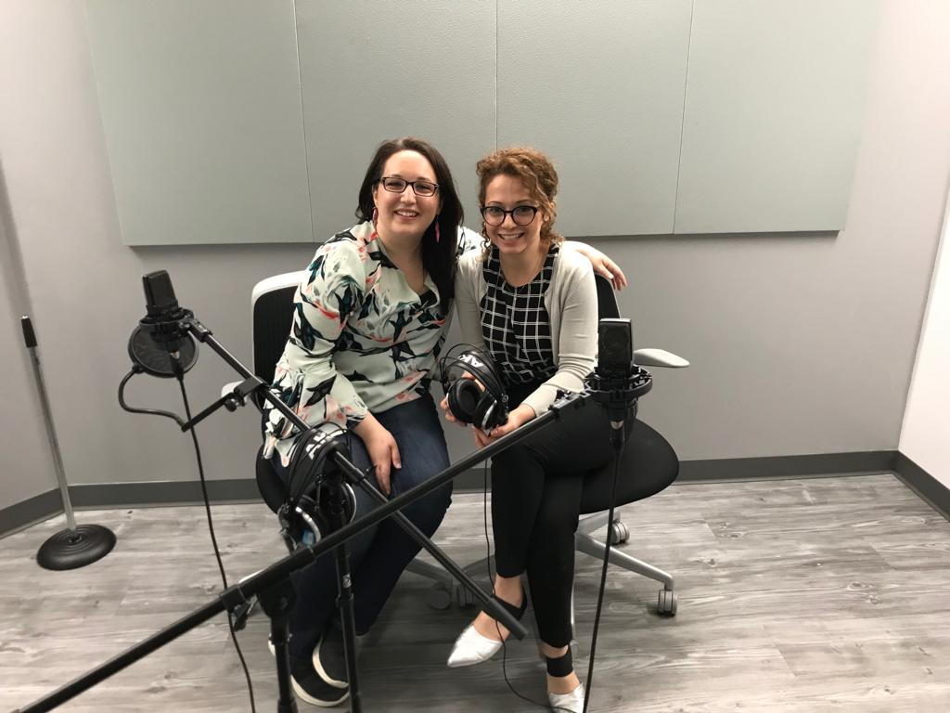
Thank you!
Listen on Apple & Spotify
Eva Stepanian
@EvaStepZak
estepanian@bramlib.on.ca

